Slide 1
Scalable Fair Clustering:
Based on IOT, ICS and SWAT Datasets.
Assignment 2
Akansha Handa
Prabhat Semwal

Slide 2
Algorithm Implementation
Accuracy Computation:
The sample points in two clusters were received after performing the K-medoid with K =2
Received “IDX” values for every point (IDX =1 and IDX =2)
Mapped the IDX values with the “target” feature (Label feature) to computed the weightage of two clusters with respected to maximum samples in one cluster
Labeled IDX =1 to benign and IDX 2 to malware based on the output:
Based on labeled clusters (IDX), calculated the predicted label based for all points
Created confusion matrix
Data points
1
2
3
4
5
6
Actual label
0
0
1
1
0
0
IDX
1
2
1
2
1
1
1-0,1,0
Predicted label
0
1
0
1
0
0
2-0,1

Slide 3
IOT Dataset

Slide 4
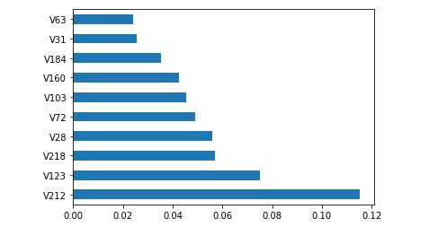
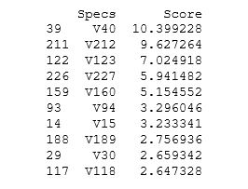
Algorithm Implementation
Dataset processing:
Processed opcode (text data) to numerical data
Converted opcodes to number format
Used Term Frequency- Inverse Document Frequency (TF-IDF)
Features obtained :236 features with 512 samples.
Five attributes section out of 236 through Scoring: Univariate feature selection and Tree-based feature selection method: “ExtraTreesclassifier”
Used top ranked features: “V212”,”V218”,”V160”, “V123” and “V227”as sensitive attribute.

Slide 5
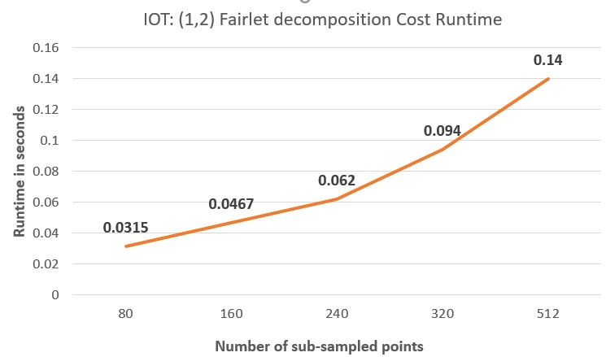
Result
Fairlet decomposition cost runtime for IOT dataset with 0.5 balance of 10 clusters

Slide 6
Results
IOT dataset with 0.5 balance of 2 clusters.
Accuracy | 87.19%
True Positive Rate | 0.85
False Positive Rate | 0.10
F1-Score | 0.87
Average Precision-Recall | 0.79

Slide 7
ICS Dataset

Slide 8
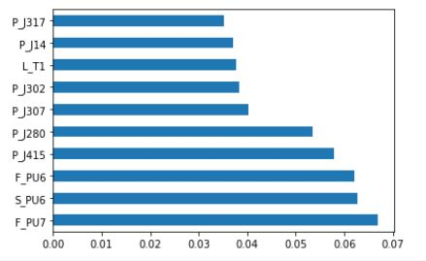
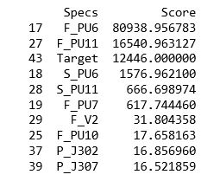
Algorithm Implementation
Dataset processing:
Features obtained :44 features with 11439 samples.
Six attributes section out of 44 through Scoring: Univariate feature selection and Tree-based feature selection method: “ExtraTreesclassifier”
Used top ranked features: “F_PU7”,”P_J280”,”P_J415”,”P_J302”,”P_J14” and “S_PU8”as sensitive attribute.

Slide 9
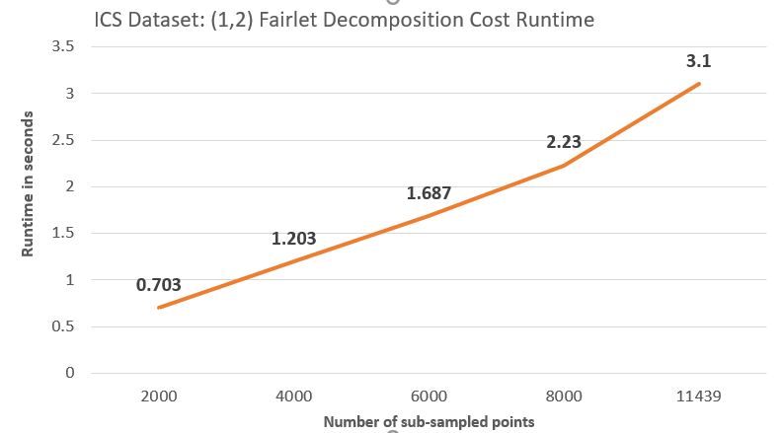
Result
Fairlet decomposition cost runtime for ICS dataset with 0.5 balance of 10 clusters

Slide 10
Results
ICS dataset with 0.5 balance of 2 clusters.
Accuracy | 84.0%
True Positive Rate | 0.84
False Positive Rate | 0.15
F1-Score | 0.91
Average Precision-Recall | 0.16

Slide 11
SWAT Dataset

Slide 12
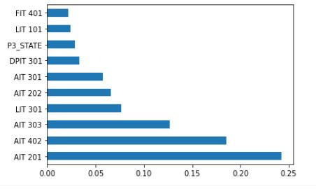
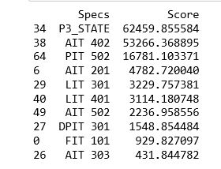
Algorithm Implementation
Dataset processing:
Features obtained : 78 features with 14994 samples.
Six attributes section out of 78 through Scoring: Univariate feature selection and Tree-based feature selection method: “ExtraTreesclassifier”
Used top ranked features: “AIT 402”,”PIT 502”,”AIT 201”,”LIT 301”,”AIT 502” and “P3_STATE”as sensitive attribute.

Slide 13
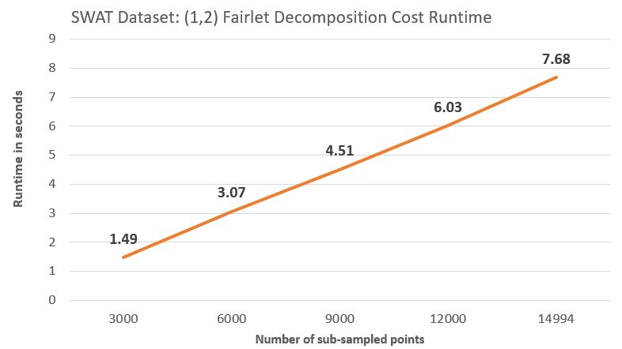
Result
Fairlet decomposition cost runtime for SWAT dataset with 0.5 balance of 10 clusters

Slide 14
Results
SWAT dataset with 0.5 balance of 2 clusters.
Accuracy | 66.6%
True Positive Rate | 0.84
False Positive Rate | 0.68
F1-Score | 0.77
Average Precision-Recall | 0.38

Slide 15
Thank You

